Slide 1
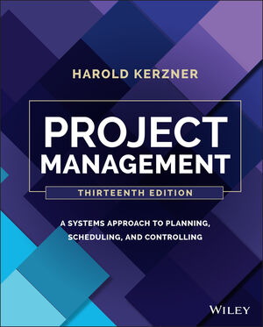
Project Management:
A Systems Approach to
Planning, Scheduling, and Controlling
Thirteenth Edition

Slide 2
Chapter One
Overview

Slide 3
Overview of Project Management
TIME
COST
RESOURCES
PERFORMANCE/TECHNOLOGY

Slide 4
Project Characteristics
Have a specific objective (which may be unique or one of a kind) to be completed within certain specifications
Have defined start and end dates
Have funding limits (if applicable)
Consume human and nonhuman resources (i.e., money, people, equipment)
Be multifunctional (cut across several functional lines)

Slide 5
Project Management
Project planning
Definition of work requirements
Definition of quantity and quality of work
Definition of resources needed
Project monitoring
Tracking progress
Comparing actual outcome to predicted outcome
Analyzing impact
Making adjustments

Slide 6
PROJECT MANAGEMENT IS THE ART OF CREATING THE ILLUSION THAT ANY OUTCOME IS THE RESULT OF A SERIES OF PREDETERMINED, DELIBERATE ACTS WHEN IN FACT IT WAS DUMB LUCK !

Slide 7
The Talent Triangle
Technical project management
Leadership
Strategic and business management

Slide 8
Multiple Boss Reporting
GM
PM = Project Manager
APM = Assistant Project Manager
LM = Line or Functional Manager
SPONSOR
PM
LM
LM
LM
APM
APM

Slide 9
WHY USE PROJECT MANAGEMENT?

Slide 10
Project management and productivity are related!

Slide 11
MATURITY IN PROJECT MANAGEMENT IS LIKE A THREE-LEGGED STOOL.
THE LEGS REPRESENT THE:
Project manager
Line manager(s)
Executive management (i.e., project sponsor)
Maturity cannot exist without stability

Slide 12
The Three-Legged Stool
Senior
Management
Project
(i.e., Sponsor)
Manager
Line
Management

Slide 13
TOP OF THE THREE-LEGGED STOOL
ORGANIZATIONAL
STRUCTURE
ORGANIZATIONAL
BEHAVIOR
TOOLS &
TECHNIQUES

Slide 14
Critical Questions
How important is project management training?
Part-time project management–
is it good or bad?

Slide 15
Role of the Project Manager

Slide 16
Negotiating for Resources

Slide 17
The Project Kickoff Meeting

Slide 18
Establishing the Project’s Policies and Procedures

Slide 19
Laying Out the Project Workflow and Plan

Slide 20
Establishing Performance Targets

Slide 21
Obtaining Funding

Slide 22
Executing the Plan

Slide 23
Acting as the Conductor

Slide 24
Putting Out Fires

Slide 25
Counseling and Facilitation

Slide 26
Encouraging the Team to Focus on Deadlines

Slide 27
Monitoring Progress by “Pounding the Pavement”

Slide 28
Evaluating Performance

Slide 29
Develop Contingency Plans

Slide 30
Briefing the Project Sponsor

Slide 31
Briefing the Team

Slide 32
Briefing the Customer

Slide 33
Closing Out the Project

Slide 34
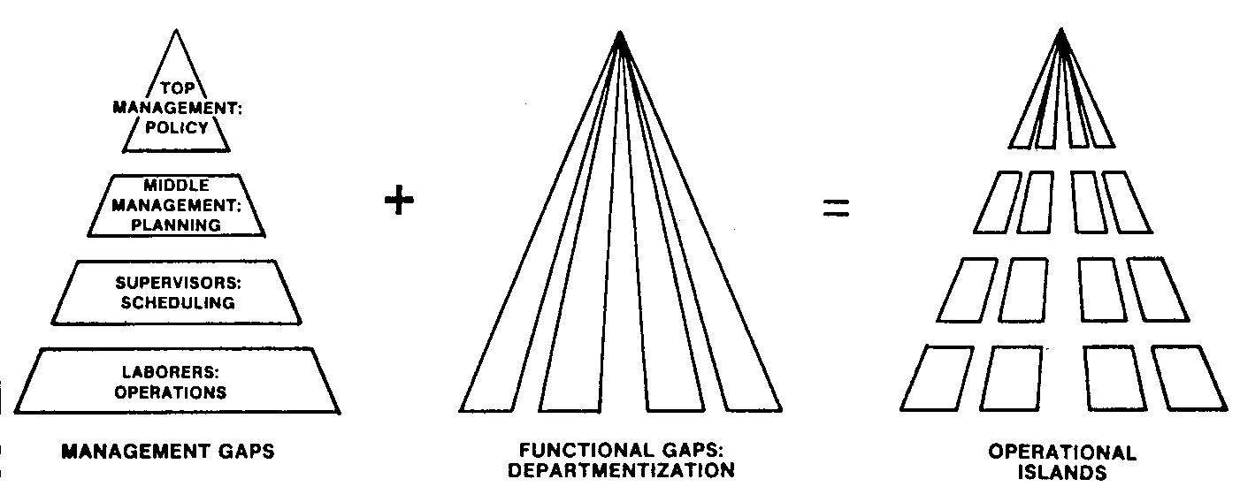
Why Is a Project Management System Necessary?

Slide 35
Project Management
Time
Cost
Resources
Quality/Technology

Slide 36
Benefits
Identification of functional responsibilities to ensure that all activities are accounted for, regardless of personnel turnover
Minimizing the need for continuous improvement
Identification of time limits for scheduling
Identification of a methodology for trade-off analysis
Measurement of accomplishment against plans

Slide 37
Benefits (continued)
Early identification of problems so that corrective action can follow
Improved estimating capability for future planning
Knowing when objectives cannot be met or will be exceeded

Slide 38
Obstacles
Project complexity
Customer’s special requirements and scope changes
Organizational restructuring
Project risks
Changes in technology
Forward planning and pricing

Slide 39
Humor
Project management is the art of creating the illusion that any outcome is the result of a series of predetermined, deliberate acts when, in fact, it was dumb luck.

Slide 40
Classical Management
Planning
Organizing
Staffing
Controlling
Directing
Which of the above is usually NOT
performed by the project manager?

Slide 41
Resources
Money
Manpower
Equipment
Facilities
Materials
Information/technology

Slide 42
Successful Culture
A good daily working relationship between the project manager and those line managers who directly assign resources to projects
The ability of functional employees to report vertically to their line manager at the same time they report horizontally to one or more project managers

Slide 43
Interface Management
Managing human interrelationships within the project team
Managing human interrelationships between the project team and the functional organization
Managing human interrelationships between the project team and senior management
Managing human interrelationships between the project team and the customer’s organization, whether an internal or external organization

Slide 44
As part of interface management, the project manager’s role also includes integration management.

Slide 45
Integration Management
Integration Management
Resources
Capital
Materials
Equipment
Facilities
Information
Personnel
Products
Services
Profits
Integrated Processes
Inputs
Outputs

Slide 46
The Functional Role
The functional manager has the responsibility to define how the task will be done and where the task will be done (i.e., the technical criteria).
The functional manager has the responsibility to provide sufficient resources to accomplish the objective within the project’s constraints (i.e., who will get the job done).

Slide 47
Functional Obstacles
Unlimited work requests (especially during competitive bidding)
Predetermined deadlines
All requests having a high priority
Limited number of resources
Limited availability of resources
Unscheduled changes in the project plan
Unpredicted lack of progress

Slide 48
Functional Obstacles (continued)
Unpredicted lack of progress
Unplanned absence of resources
Unplanned breakdown of resources
Unplanned loss of resources
Unplanned turnover of personnel

Slide 49
Most projects also have a project sponsor, who may or may not reside at the executive level of management.

Slide 50
The Project Sponsor Interface
Project Sponsor: Senior Management
Priority Projects
Project Sponsor: Lower/Middle Management
Maintenance Projects
Relationship:
Project Sponsor
Objective setting
Up-front planning
Project organization
Key staffing
Master plan
Policies
Monitoring execution
Priority-setting
Conflict resolution
Executive-client contact
Project Manager
Project Team
Project Manager

Slide 51
Project Necessities
Complete task definitions
Resource requirement definitions (and possibly skill levels needed)
Major timetable milestones
Definition of end-item quality and reliability requirements
The basis for performance measurement

Slide 52
Results of Good Planning
Assurance that functional units will understand their total responsibilities toward achieving project needs
Assurance that problems resulting from scheduling and allocation of critical resources are known beforehand
Early identification of problems that may jeopardize successful project completion so that effective corrective action and replanning can occur to prevent or resolve problems

Slide 53
Promises Made???
Promotion
Grade
Salary
Bonus
Overtime
Responsibility
Future work assignments

Slide 54
Project Managers vs. Champions
Project Managers | Project Champions
Prefer to work in groups | Prefer working individually
Committed to their managerial and technical responsibilities | Committed to technology
Committed to the corporation | Committed to the profession
Seek to achieve the objective | Seek to exceed the objective
Are willing to take risks | Are unwilling to take risks; try to test everything
Seek what is possible | Seek perfection
Think in terms of short time spans | Think in terms of long time spans
Manage people | Manage things
Are committed to and pursue material values | Are committed to and pursue intellectual values

Slide 55
Project Management in Non-Project-Driven Groups
Projects may be few and far between.
Not all projects have the same project management requirements, and therefore they cannot be managed identically. This difficulty results from poor understanding of project management and a reluctance of companies to invest in proper training.
Executives do not have sufficient time to manage projects themselves, yet refuse to delegate authority.

Slide 56
Project Management in Non-Project-Driven Groups (Continued)
Projects tend to be delayed because approvals most often follow the vertical chain of command. As a result, project work stays too long in functional departments.
Because project staffing is on a “local” basis, only a portion of the organization understands project management and sees the system in action.
There exists heavy dependence on subcontractors and outside agencies for project management expertise.

Slide 57
High-Level Reporting
The project manager is charged with getting results from the coordinated efforts of many functions. He or she should, therefore, report to the person who directs all those functions.
The project manager must have adequate organizational status to do his or her job effectively.
To get adequate and timely assistance in solving problems that inevitably appear in any important project, the project manager needs direct and specific access to an upper echelon of management .

Slide 58
High-Level Reporting (Continued)
The customer, particularly in a competitive environment, will be favorably impressed if his or her project manager reports to a high organizational echelon.

Slide 59
Low-level Reporting
It is organizationally and operationally inefficient to have too many projects, especially small ones, diverting senior executives from more vital concerns.
Although giving a small project a high place in the organization may create the illusion of executive attention, its real result is to foster executive neglect of the project.
Placing a junior project manager too high in the organization will alienate senior functional executives on whom he or she must rely for support.

Slide 60
THE TIP-OF-THE-ICEBERG SYNDROME
DELEGATION
OF AUTHORITY TO
PROJECT MANAGER
EXECUTIVE
MEDDLING
LACK OF UNDERSTANDING OF HOW PROJECT
MANAGEMENT SHOULD WORK
LACK OF TRAINING IN COMMUNICATIONS /
INTERPERSONAL SKILLS
MANY OF THE PROBLEMS ASSOCIATED WITH PROJECT MANAGEMENT WILL
SURFACE MUCH LATER IN THE PROJECT AND RESULT IN MUCH HIGHER COSTS

Slide 61
Project vs. Functional Influences
Project Influence
in Decision Making
Relative Influence
Functional Influence
Dual Influence
In Decision Making
Functional
Matrix
Project
Organization
Organization
Organization

